Slide 1
Monopolistic Competition
CHAPTER 16
Notes:
N. Gregory Mankiw Principles Of Economics Eight Edition

Slide 2
Monopolistic Competition, Part 1
Imperfect competition
Between perfect competition and monopoly
Oligopoly
Monopolistic competition
Oligopoly
Few sellers
Offer similar or identical products

Slide 3
Monopolistic Competition, Part 2
Concentration ratio
Percentage of total output in the market supplied by the four largest firms
Oligopolies, highly-concentrated industries (concentration ratio %)
Major household appliances (90%)
Tires (91%), Light bulbs (92%)
Soda (94%)
Wireless telecommunications (95%)

Slide 4
Monopolistic Competition, Part 3
Monopolistic competition
Many sellers
Product differentiation
Not price takers
Downward sloping demand curve
Free entry and exit
Zero economic profit in the long run

Slide 5
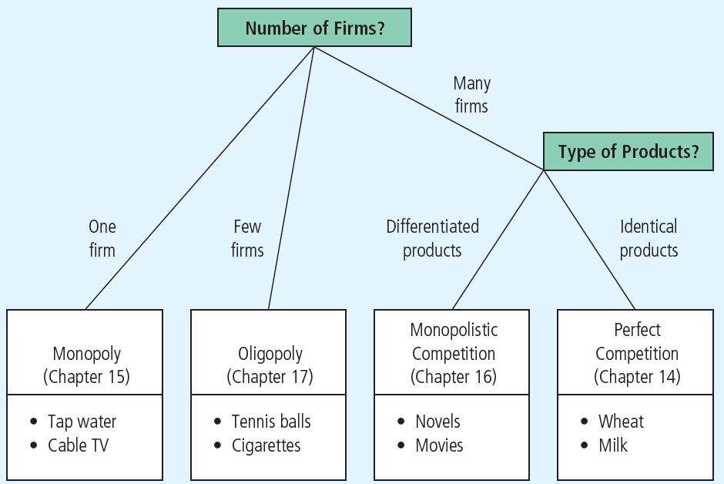
Figure 1 The Four Types of Market Structure
Economists who study industrial organization divide markets into four types—monopoly, oligopoly, monopolistic competition, and perfect competition.

Slide 6
Short Run Equilibrium
Profit maximization
Produce the quantity where marginal revenue = marginal cost
Price: on the demand curve
If P > ATC: profit
If P < ATC: loss
Similar to monopoly

Slide 7
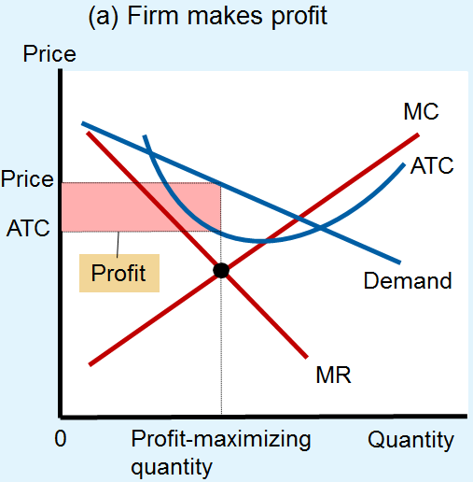
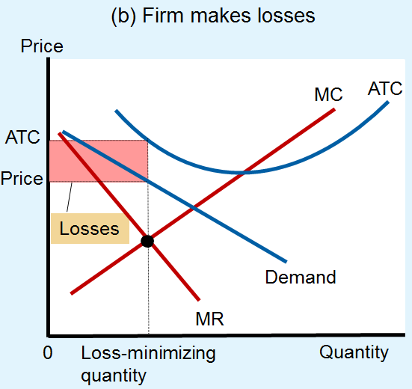
Figure 2 Monopolistic Competitors in the Short Run
Monopolistic competitors, like monopolists, maximize profit by producing the quantity at which marginal revenue equals marginal cost. The firm in panel (a) makes a profit because, at this quantity, price is greater than average total cost. The firm in panel (b) makes losses because, at this quantity, price is less than average total cost.

Slide 8
Long Run Equilibrium, Part 1
If firms are making profit in short run
New firms - incentive to enter the market
Increase number of products
Reduces demand faced by each firm
Demand curve shifts left
Each firm’s profit declines until: zero economic profit

Slide 9
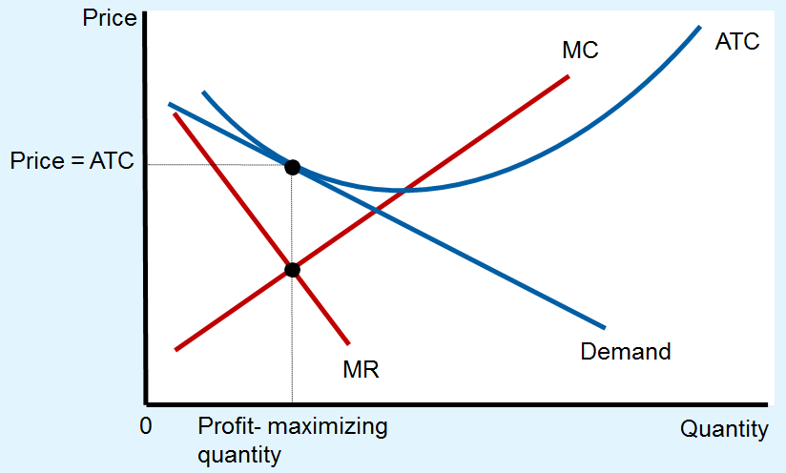
Figure 3 A Monopolistic Competitor in Long Run
In a monopolistically competitive market, if firms are making profits, new firms enter, causing the demand curves for the incumbent firms to shift to the left. Similarly, if firms are making losses, some of the firms in the market exit, causing the demand curves of the remaining firms to shift to the right. Because of these shifts in demand, monopolistically competitive firms eventually find themselves in the long-run equilibrium shown here. In this long-run equilibrium, price equals average total cost, and each firm earns zero profit.

Slide 10
Long Run Equilibrium, Part 2
Zero economic profit
Demand curve
Tangent to average total cost curve
At quantity where marginal revenue = marginal cost
Price = average total cost
Price exceeds marginal cost

Slide 11
Long Run Equilibrium, Part 3
Monopolistic versus perfect competition
Monopolistic competition
Quantity: not at minimum ATC (excess capacity)
P > MC, markup over marginal cost
Perfect competition
Quantity: at minimum ATC (efficient scale)
P = MC

Slide 12
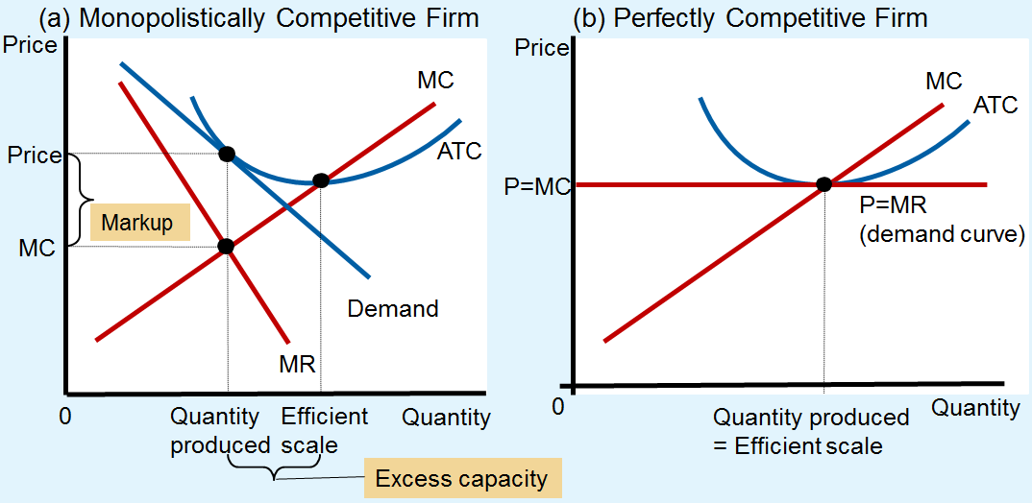
Figure 4 Monopolistic versus Perfect Competition
Panel (a) shows the long-run equilibrium in a monopolistically competitive market, and panel (b) shows the long-run equilibrium in a perfectly competitive market. Two differences are notable. (1) The perfectly competitive firm produces at the efficient scale, where average total cost is minimized. By contrast, the monopolistically competitive firm produces at less than the efficient scale. (2) Price equals marginal cost under perfect competition, but price is above marginal cost under monopolistic competition.

Slide 13
Welfare of Society
Sources of inefficiency
Markup of price over marginal cost
Deadweight loss of monopoly pricing
Too much or too little entry
Product-variety externality (positive externality on consumers)
Business-stealing externality (negative externality on existing firms)

Slide 14
Advertising, Part 1
Incentive to advertise
When firms sell differentiated products and charge prices above marginal cost
Advertise to attract more buyers
Advertising spending
Highly differentiated goods: 10-20% of revenue
Industrial products: Little advertising
Homogenous products: No advertising

Slide 15
Advertising, Part 2
Debate over advertising
Wasting resources?
Valuable purpose?
The critique of advertising
Firms advertise to manipulate people’s tastes
Psychological rather than informational
Creates a desire that otherwise might not exist

Slide 16
Advertising, Part 3
The critique of advertising
Impedes competition
Increase perception of product differentiation
Foster brand loyalty
Makes buyers less concerned with price differences among similar goods

Slide 17
Advertising, Part 4
The defense of advertising
Provide information to customers
Customers - make better choices
Enhances the ability of markets to allocate resources efficiently
Fosters competition
Customers - take advantage of price differences
Allows new firms to enter more easily

Slide 18
Advertising and the price of eyeglasses, Part 1
What effect does advertising have on the price of a good?
Consumers – view products as being more different than they otherwise would
Markets less competitive
Firms’ demand curves less elastic
Higher prices

Slide 19
Advertising and the price of eyeglasses, Part 2
What effect does advertising have on the price of a good?
Consumers – easier to find firms with the best prices
Markets – more competitive
Firms’ demand curves more elastic
Lower prices

Slide 20
Advertising and the price of eyeglasses, Part 3
1972, economist Lee Benham
States that prohibited advertising
Average price = $33 ($248 in 2012 dollars)
States that did not restrict advertising
Average price = $26 ($196 in 2012 dollars)
Advertising
Reduced average prices
Fosters competition

Slide 21

Advertising, Part 5
Advertising as a signal of quality
Little apparent information
Real information offered – a signal
Willingness to spend large
amount of money
= signal about quality of the product
Content of advertising = irrelevant
Is it rational for consumers to be impressed that Jennifer Aniston is endorsing this product?

Slide 22
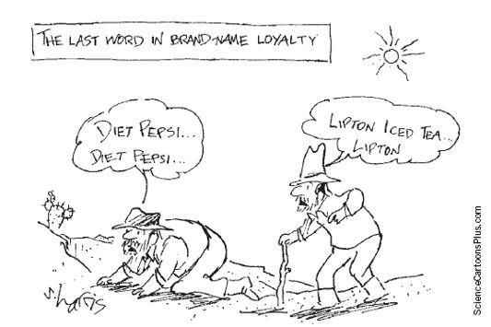
Advertising, Part 6
Brand names
Spend more on advertising and charge higher prices than generic substitutes

Slide 23
Advertising, Part 7
Critics of brand names
Products – not differentiated
Irrationality: consumers are willing to pay more for brand names
Defenders of brand names
Consumers – information about quality
Firms – incentive to maintain high quality

Slide 24
Table 1 Monopolistic Competition: Between Perfect Competition and Monopoly
Empty cell | Empty cell | Market Structure | Empty cell
Empty cell | Perfect Competition | Monopolistic Competition | Monopoly
Features that all three market structures share | Empty cell | Empty cell | Empty cell
Goal of firms | Maximize profits | Maximize profits | Maximize profits
Rule for maximizing profit | MR= MC | MR= MC | MR= MC
Can earn economic profits in the short run? | Yes | Yes | Yes
Features that monopolistic competition shares with monopoly | Empty cell | Empty cell | Empty cell
Price taker? | Yes | No | No
Price | P = MC | P > MC | P> MC
Produces welfare-maximizing level of output? | Yes | No | No
Features that monopolistic competition shares with perfect competition | Empty cell | Empty cell | Empty cell
Number of firms | Many | Many | One
Entry in the long run? | Yes | Yes | No
Can earn economic profits in the long run? | No | No | Yes

